Slide 1
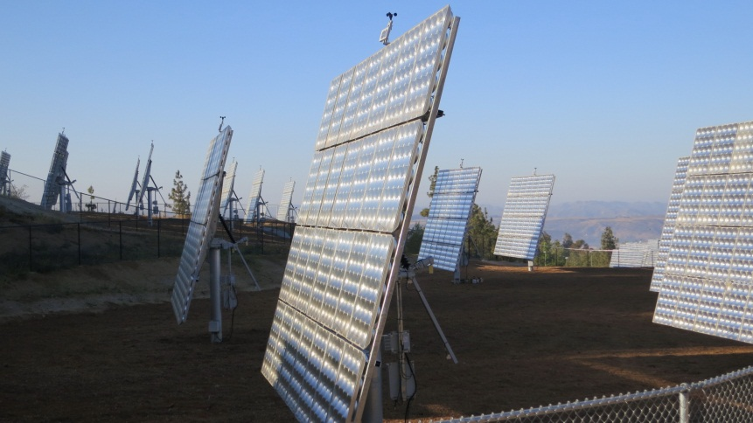
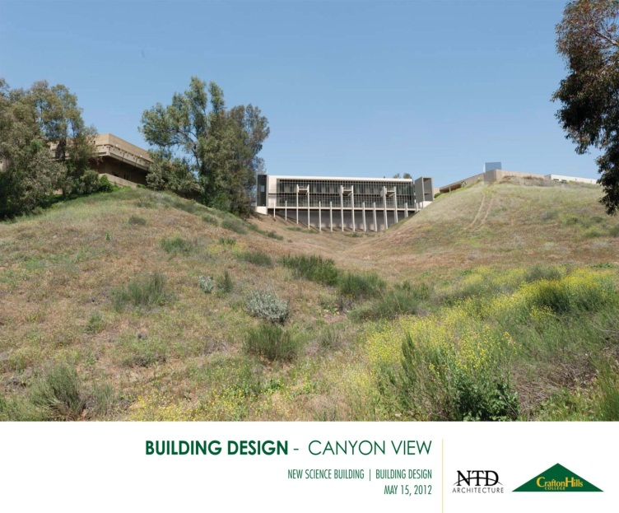
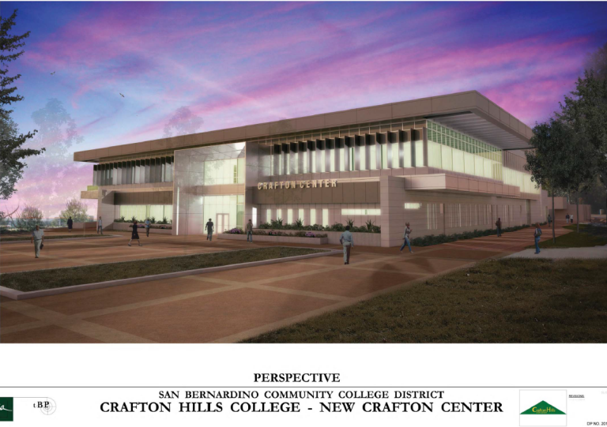
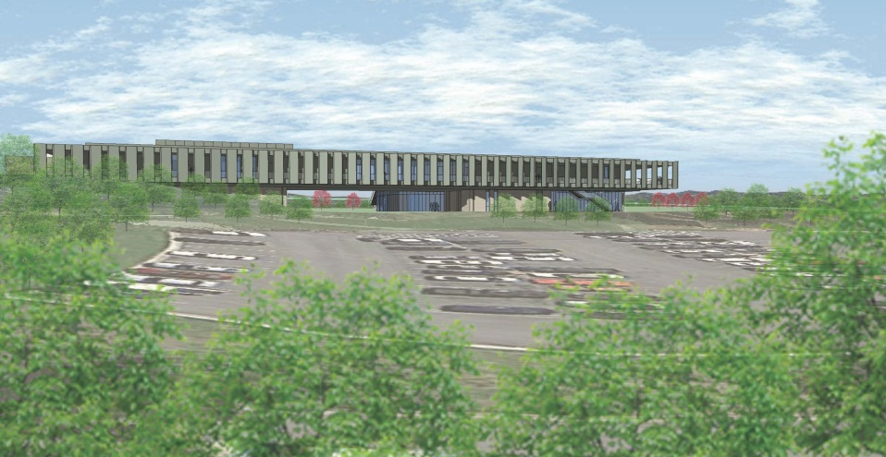
Campus Updates
CHC Administrative Services

Slide 2
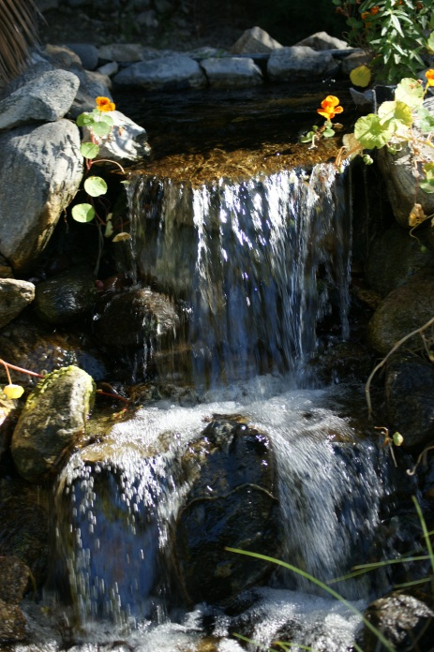
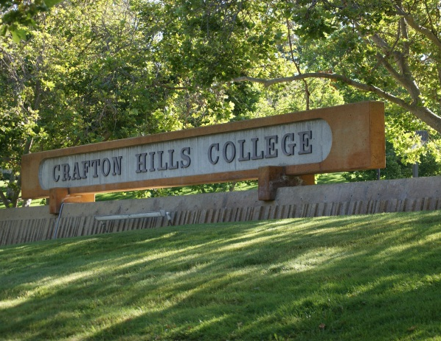

Updates Outline
M&O and Construction
Planning and Program Review – Resource Requests
CHC Budget

Slide 3
M&O Summer Projects
Campus-wide top-to-bottom team cleaning – All Buildings
Fire Alarm Upgrades
Cafeteria reconfiguration
M&O shop cleanup (thanks to A&R, Fin Aid, Student Life for cooperation)
Pressure wash sidewalks
Countless construction meetings
Notes:
In addition to regular tasks the M&O staff completed
LC walked 80 mi of John Muir Trail

Slide 4
Construction
Parking Lot Lighting and ADA Pathways
Solar hot water heating project
Solar Farm
Design of new Science Building, OE2, Crafton Center, and PE
Renovation architect selection (PMSM Architects)

Slide 5

Solar Farm
Notes:
June and July stats = percentage of power generated/total used, savings of…; June 2011

Slide 6
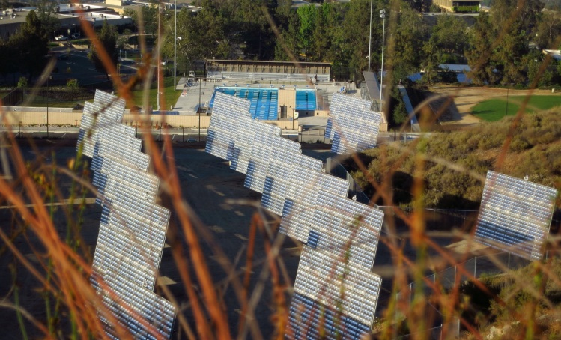
Solar Farm Stats
Solar Farm Stats
Month | kWh Used | kWh Generated | kWh Total | Cost | Generation Percent
June 2012 | 107,861 | 74,770 | 33,091 | $ 18,526.10 | 69%
July 2012 | 124,603 | 96,451 | 28,152 | $ 19,883.97 | 77%
Potential is 1.29MW = savings of $413k/year

Slide 7
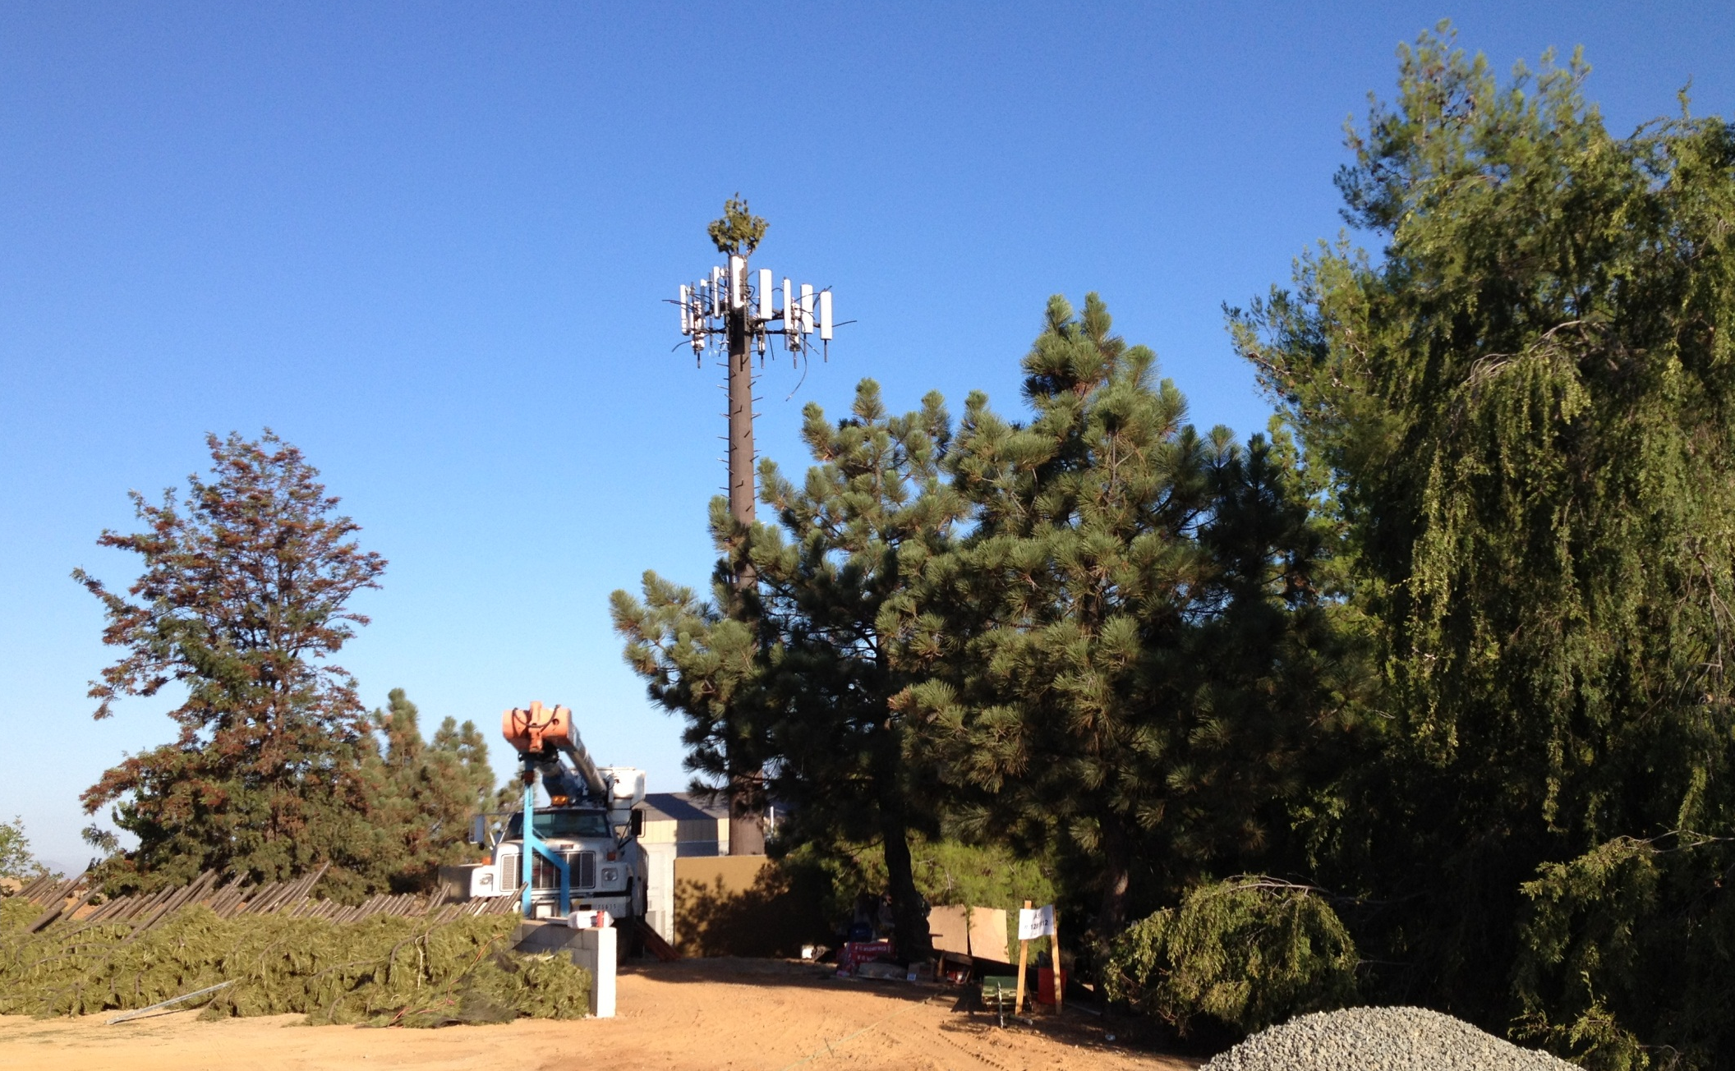
Verizon Cell Tower
$26k 1st year, $21k per year with CPI adjustments each year thereafter

Slide 8


Slide 9
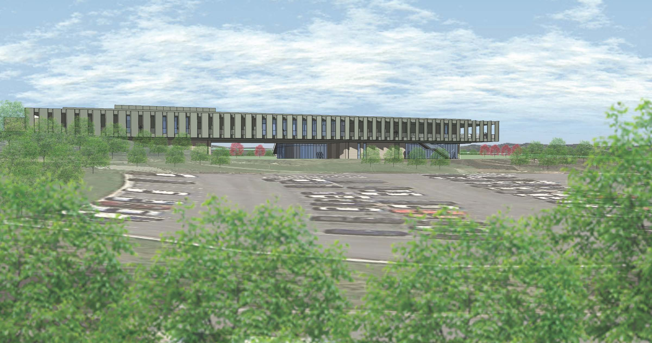
Public Safety Facility (new OE2)

Slide 10


Slide 11
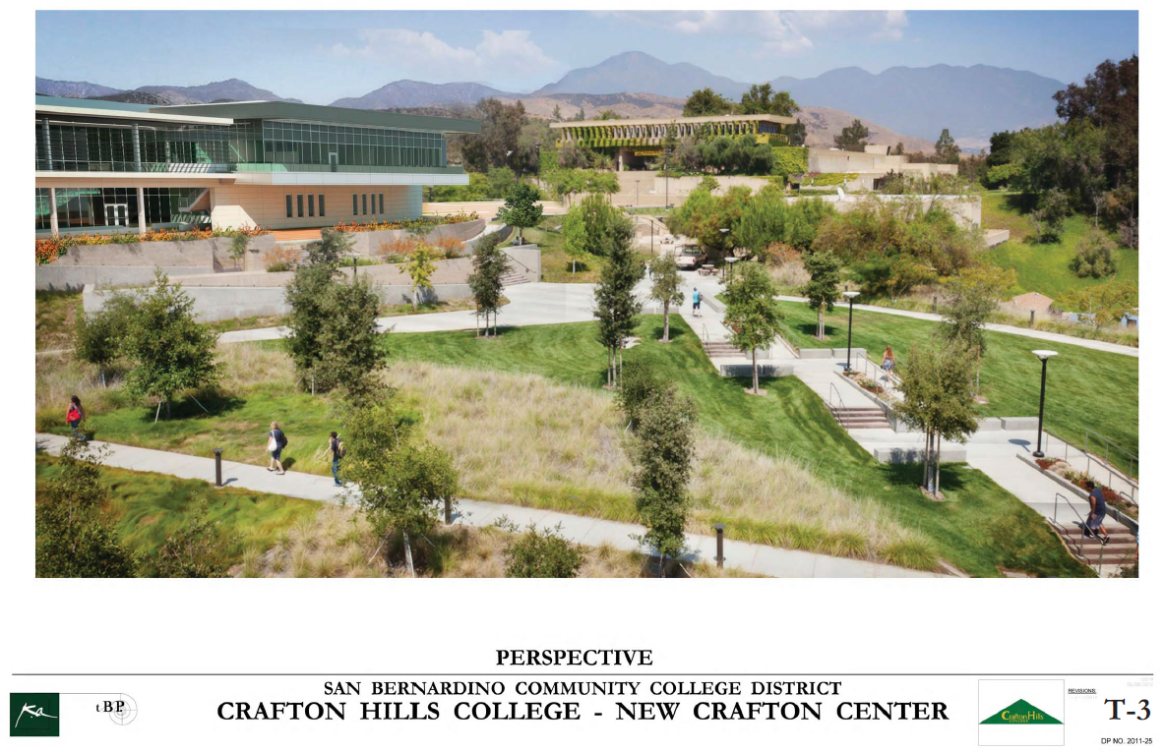

Slide 12
CHC 2012-2013 Budget
$18,837,337 total general fund budget
$17,086,265 allocation
-$1,751,072 shortfall (scenario A=current plan)
FTES
  3,810 FTES (scenario A)

Slide 13
PPR Prioritized Objectives/Resource Requests
2011 planning year
  131 objectives (63 requested funding)
  49/63 (78%) were funded or partially funded
2012 planning year
  473 objectives (119 requested funding)
  TBD/117 funded or partially funded

